Slide 1

Evaluating the CO2 Emission from Gasoline-Powered Light-Duty Vehicles
Group 5 – Applied Machine Learning
Han Chau - 20012654
Randy Duong - 20019147
Nihar Dugade - 20018679

Slide 2
Content
Problem and research question
Data description and insights
Data pre-processing
Method
Analysis and results
Conclusion

Slide 3
Problem and research question
Can we accurately predict whether the CO2 emissions of a car exceed the allowed threshold using machine learning models?
Can the chosen model be used as a practical tool for monitoring and controlling CO2 emissions in real-time scenarios?

Slide 4
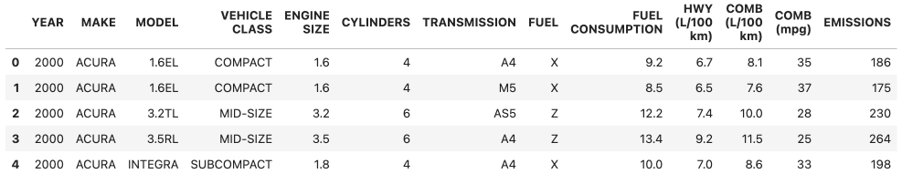
Data description and insights
Taken from Kagle with 22,556 examples and 13 columns.
Datasets provide model-specific fuel consumption ratings and estimated carbon dioxide emissions for new light-duty vehicles for retail sale in Canada.

Slide 5
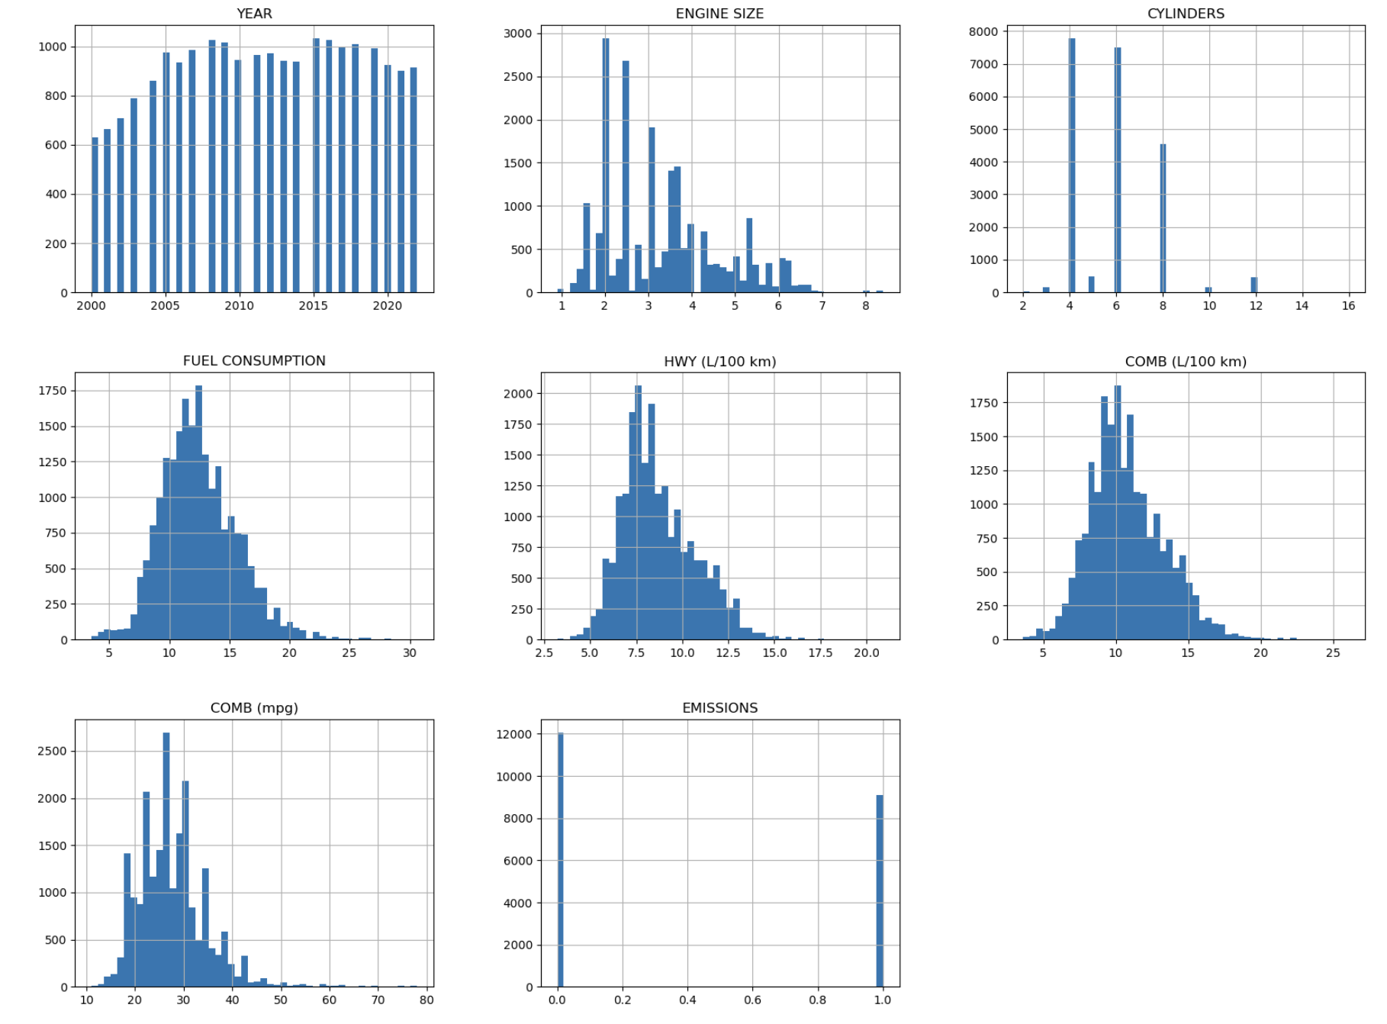
Data description and insights

Slide 6
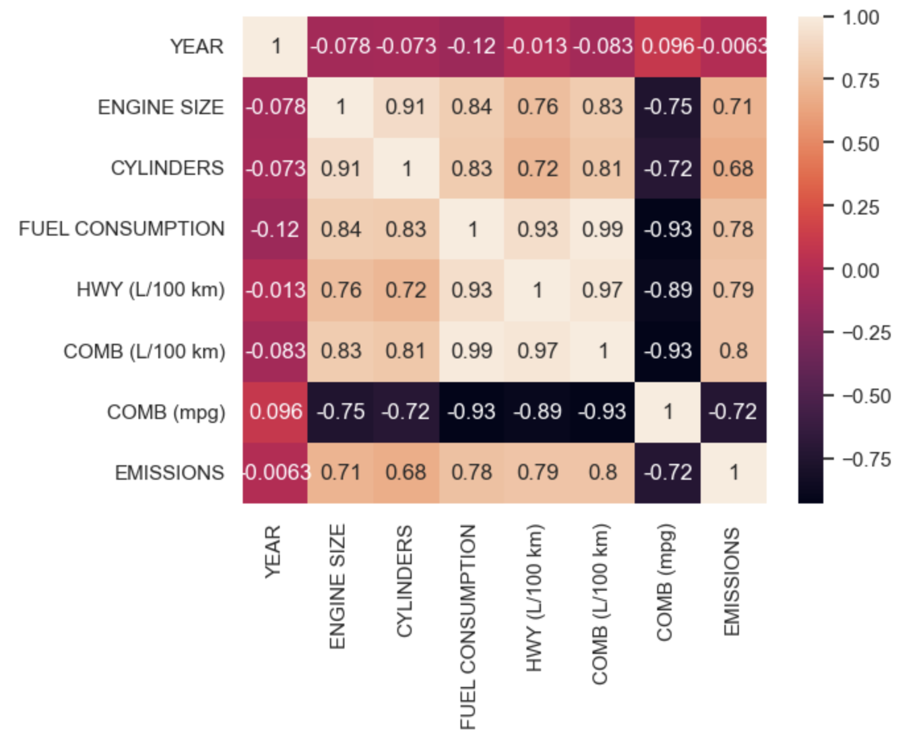
Data description and insights

Slide 7

Data pre-processing
Drop examples which the types of fuel is not Gasoline.
Transform the emission columns into binary values (1 and 0) depending on whether they exceed the threshold.
Eliminate outliers by considering the interquartile range (IQR) of the fuel consumption variable.

Slide 8
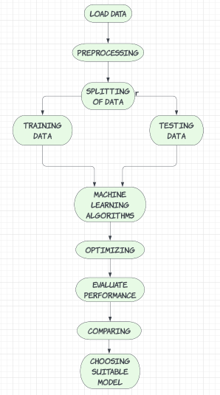
METHOD

Slide 9

Machine Learning Algorithms
Logistic Regression
Linear SVC
Random Forest
Neural Network
Naïve Bayes

Slide 10
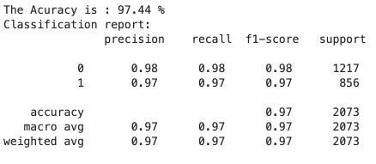
Logistic regression model
Set default for the initial parameters.

Slide 11
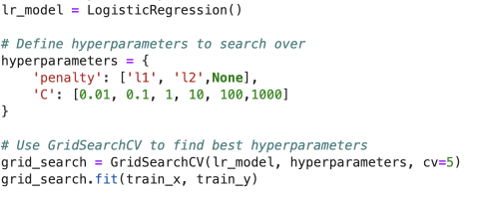

Logistic regression model
SelectKBest and GridSearchCV
Optimizing the model with GridSearchCV

Slide 12
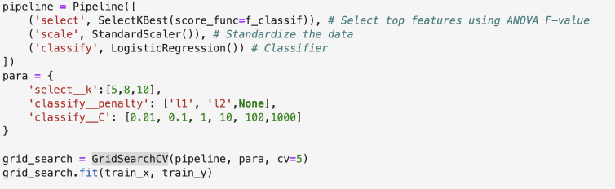
Logistic regression model
Optimizing the model with SelectKBest and GridSearchCV

Slide 13
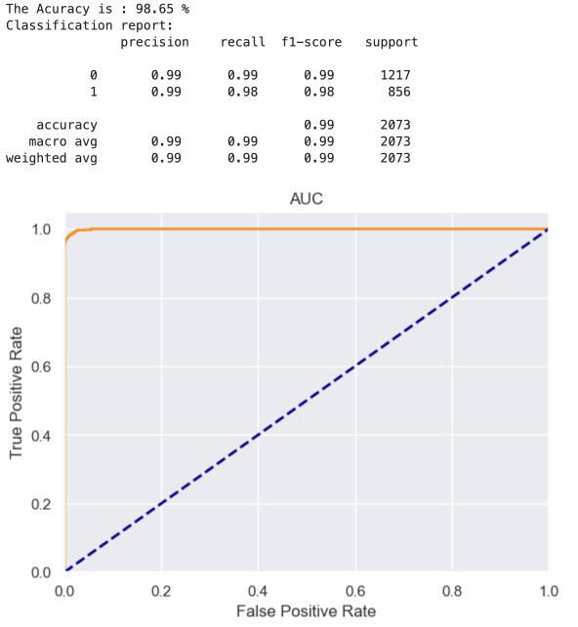
Logistic regression model
The accuracy for the test set

Slide 14
Linear SVC
The accuracy of the linear SVC model was 97.35% initially.
However, the cross-validation showed a lower accuracy of 92.97%, revealing the model’s bias.

Slide 15
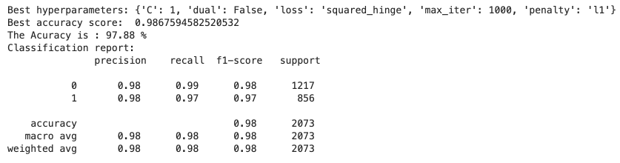
Linear SVC
Optimizing the model with GridSearchCV

Slide 16
Random Forest
Set the initial parameter:
RandomForestClassifier(n_estimators = 5,max_leaf_nodes = 5,random_state=42)
The Accuracy is : 99.13 %

Slide 17
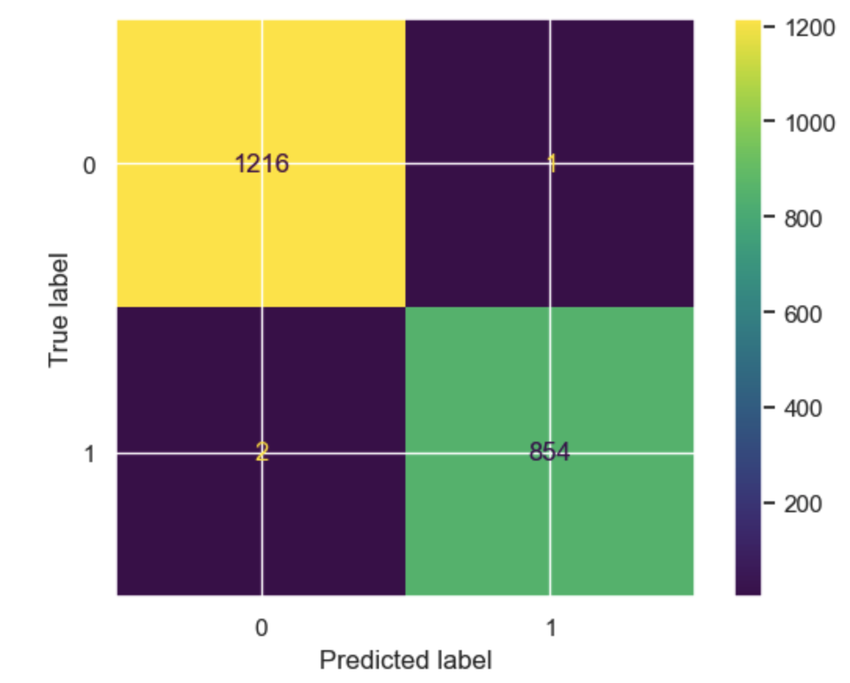
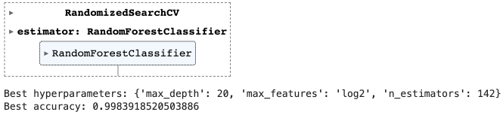
Random Forest

Slide 18
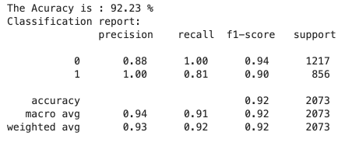
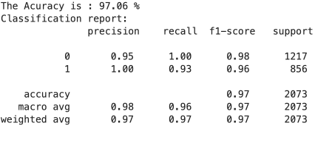
Neural Network
Best Parameters: {'solver': 'adam', 'max_iter': 1000, 'learning_rate_init': 0.001, 'hidden_layer_sizes': (10, 5), 'alpha': 0.01, 'activation': 'logistic'}

Slide 19
Naïve Bayes
The Naïve Bayes model initially achieved a high accuracy score of 95.8%.
The model’s performance worsened after using GridSearchCV to optimize the var_smoothing parameter.
Combining the SelectKBest and GridSearchCV significantly improved the accuracy score of 96.33%.

Slide 20

The time train the optimized model
Logistic regression: 0.05 seconds
SVM: 0.83 seconds
Random forest: 0.73 seconds
Neural network: 1.43 seconds
Naive Bayes: 0.01 seconds

Slide 21
Conclusion
The Random Forest model demonstrated the highest accuracy score and f1-scores for both classes, making it the top performer.
Meanwhile, the naive Bayes is the fastest model to train and predict.
However, the Logistic Regression model is a suitable choice for predicting and evaluating our dataset in this project.

Slide 22

Thank you

